Slide 1
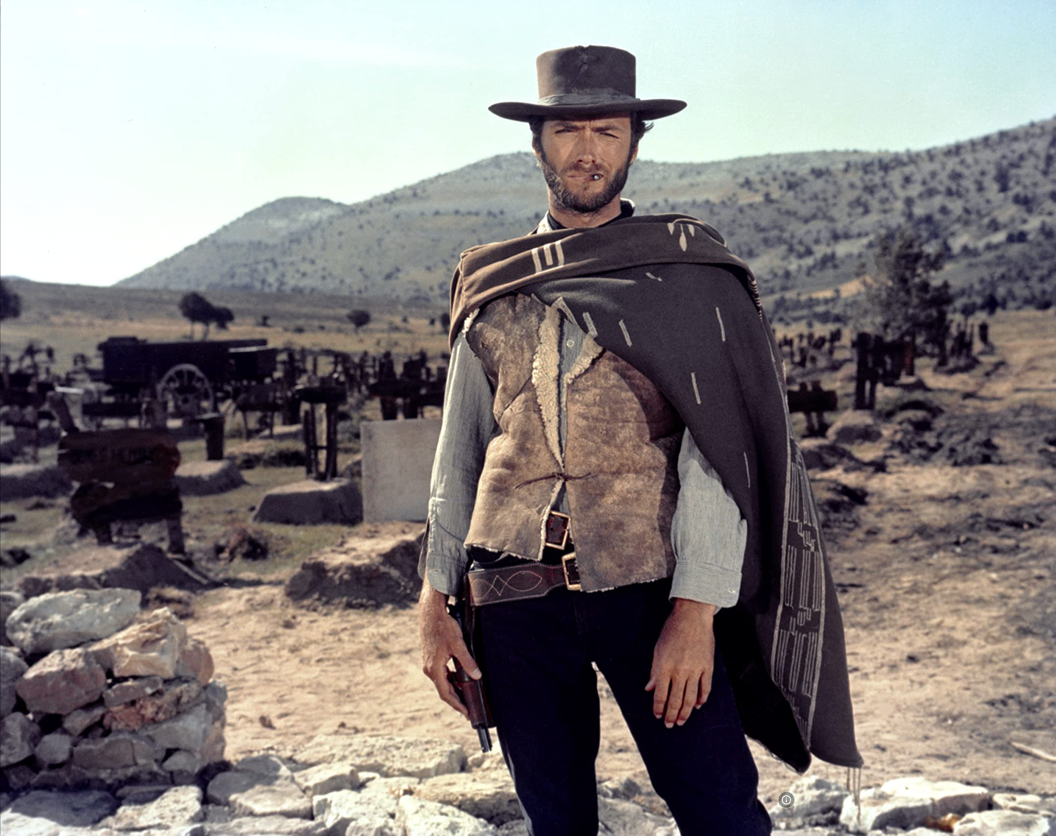

The Easy, the Hard and the Ugly
Easy
Inference (fit)
Fine-Tuning (predict)
Hard
Pre-training
Ugly (Responsible AI)
Bias
Toxicity
Misinformation
Hallucinations
Plagiarism

Slide 2
Easy: Outline
NLP
prompt engineering
inference (predict)
fine-tuning (fit)
IR
Quick recap
1 slide on hard problems for researchers/practitioners

Slide 3
Easy - IR
Inverted index solutions
Elastic Search, Solr, Lucene
SQL-contains
Basic multilingual support
Out-of-the-box ranking
Simple 10-blue links with any UX framework
Lots of open-source solutions

Slide 4
Ranking models
Classical models
Boolean
Vector space
Probabilistic (BM25, LMs, Bayesian networks)
Web
PageRank
Hubs & Authorities
Neural
Semi-structured text

Slide 5
IR - Relevance evaluation
Metrics
Precision, recall, nDCG, etc.
Evaluate using gold set
Crowdsource with a budget
Simple click instrumentation

Slide 6
Easy: If you are a Researcher/Practioner
What can you do right now
without too much effort
What other low hanging fruits are out there?
Research opportunities
Pros/Cons
Pointers to related work

Slide 7
Prompt Engineering
Super-Popular
Super-Easy
Easier than Fine-Tuning (and Inference)
Use Cases
“Helping” with homework:
Cheating (?)
Documentation:
Alternative to stack overflow

Slide 8
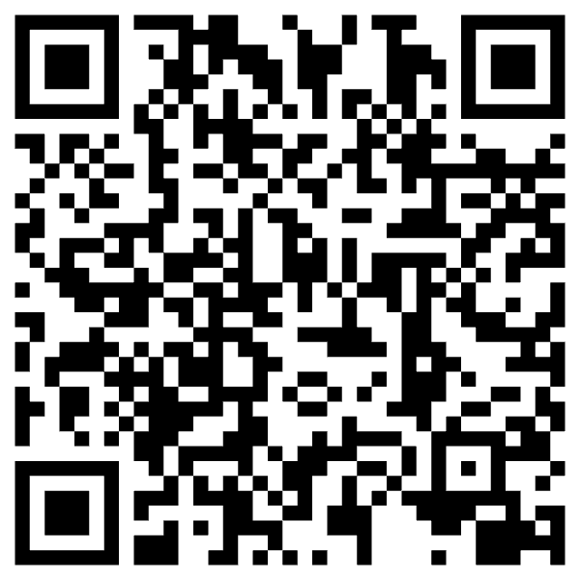
“Helping” with homework: Cheating (?)
Collaborate with students on essays
You have no idea how much we’re using ChatGPT
Cheating?
ChatGPT is better for some tasks
Good: thesis statements, outlines
Bad: capture student’s voice
Worse: quotes
Learning opportunity:
How to decompose writing to subtasks
Collaboration is great,
but student is responsible for end-product

Slide 9
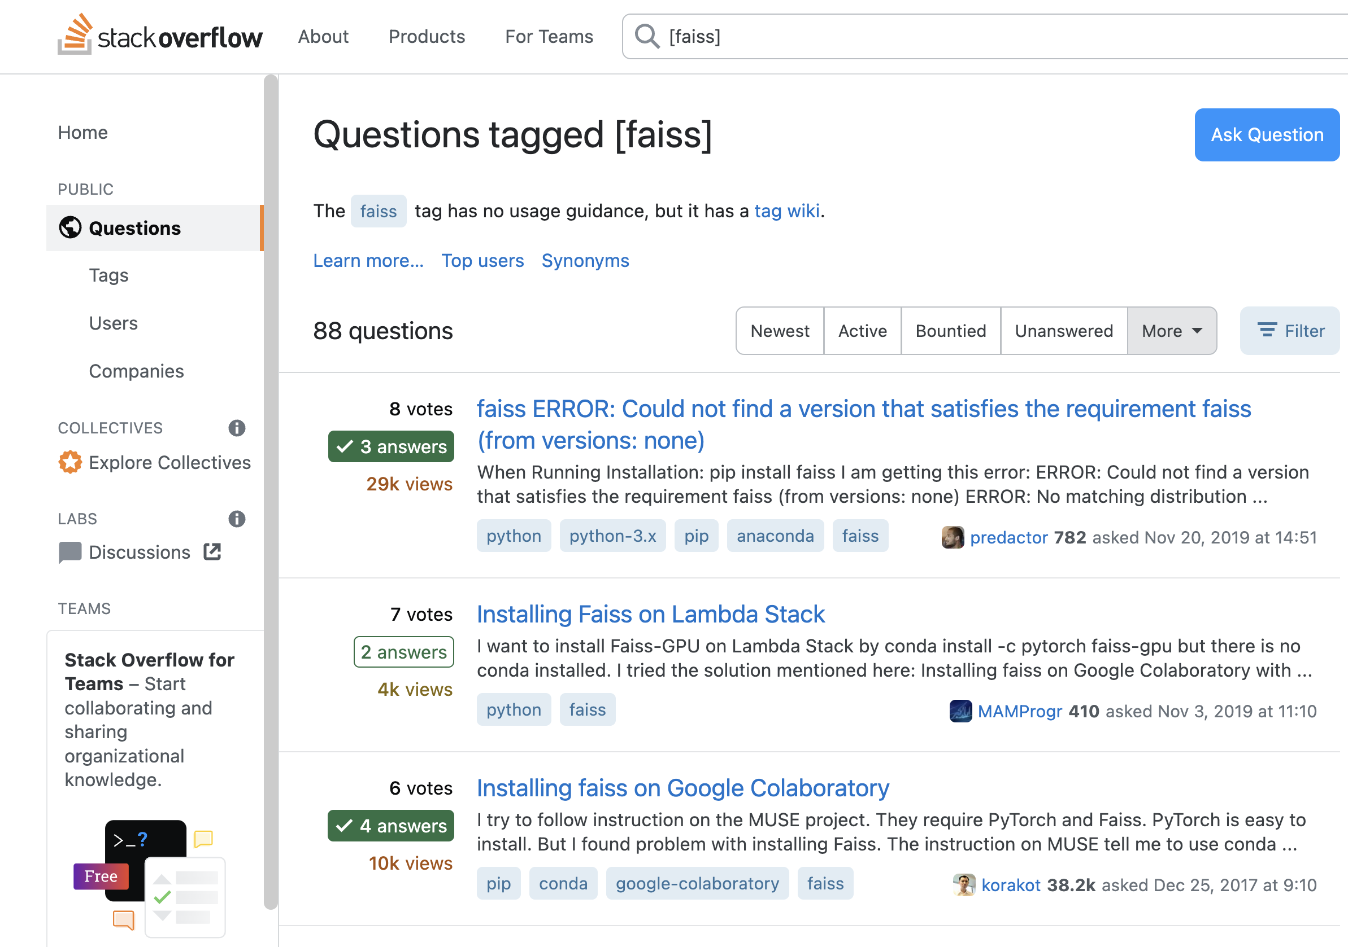

Slide 10
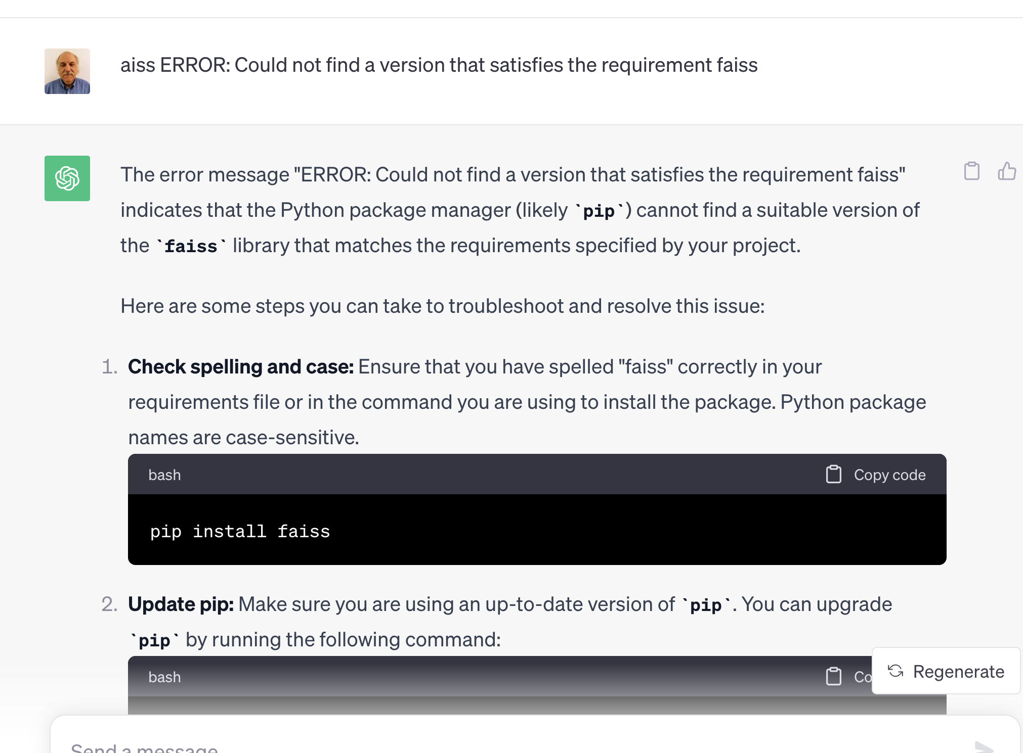
Replacing Stackoverflow with ChatGPT

Slide 11
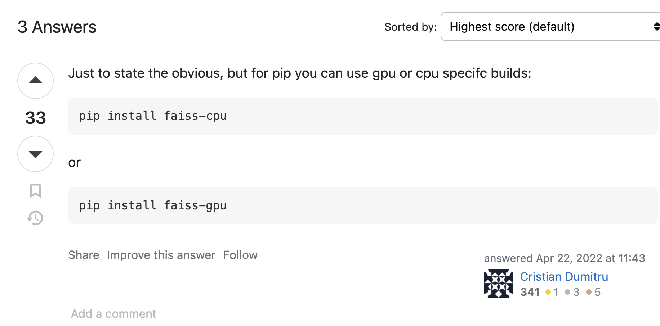
I may be old-fashioned, but I still use Stackoverflow…
Advantages of Stackoverflow
Behavioral signals: logs, votes
Wisdom of the crowd
Feedback to developers
Bug Reports
with stats (prioritization)
and workarounds (with votes)
Web search
Solitaire
Multi-player game (auction)
If we lose stackoverflow
Developers will suffer
Where does ChatGPT get its content?
Stackoverflow?

Slide 12
Decomposing a big problem into subtasks

Slide 13
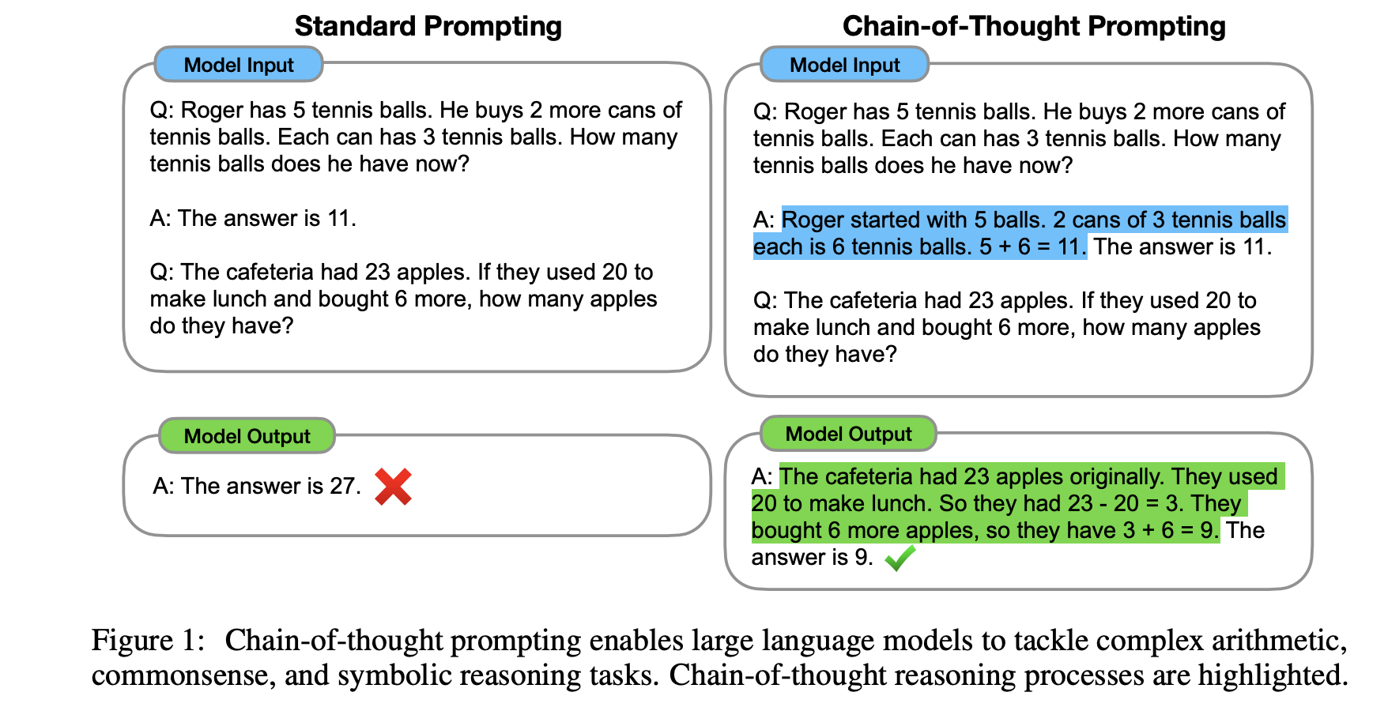

Slide 14
Limitations
Decomposing Problems
Hypothetical
Chain-of-Thought Prompting
works because...
ChatGPT needs help decomposing problems into subtasks
Suppose ChatGPT
can add two small numbers
But for large numbers,
it makes up answers
After each release,
“small” gets “bigger”
(We will return to this later)

Slide 15
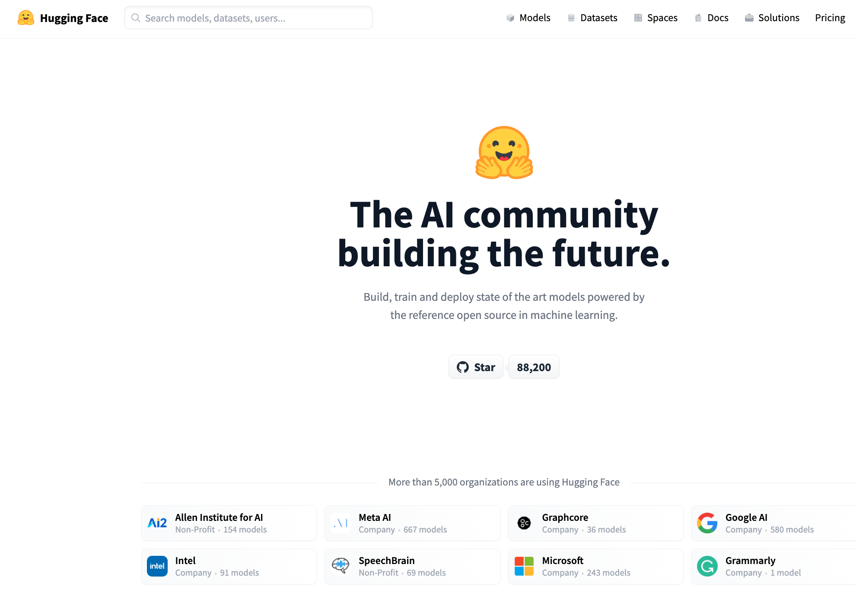


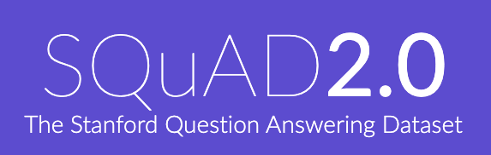

Resources
DataSets (Benchmarks)
Hubs
Examples
GLUE (NYU)
SQuAD (Stanford)
Features
Splits:
Test, Validation (Dev), Train
Metrics
Leaderboard
Examples
HuggingFace https://huggingface.co/
PaddleHub (Baidu, China)
Features
Datasets (50k)
Models (300k)
Apps (100k)
Community Engagement
(Social Media)
Growing Quickly
($≈10$x/year)

Slide 16
Prompt Engineering
In-context learning
New capabilities can be unlocked in LLMs
LLM is prompted with a few in-context demonstrations
Learns to perform a certain task
Task performance is very sensitive to prompts

Slide 17
Prompt structure
Relevance evaluation task
Task instructions
You are a search quality rater evaluating relevance of web pages
Query-document pair to be labelled
Query {query}
Document {document}
Relevant?
Re-state the task
Output format

Slide 18
Discussion
In favor
LLMs are able to produce an explanation
This could be used to assist humans in relevance judgements
Against
LLMs are not users
IR is about relevance to an information need
No proof that evaluation by LLM has any relationship to reality

Slide 19
The main process is unchanged
Regardless if labeling is done by machines or humans
Three main components
Task design
HIT or prompt engineering
Data
Crowd
Human-based crowd or LLM-based crowd
Quality control
Debugging

Slide 20
Standard 3-Step Recipe
Step | Description | Time | Hardware
1
2
3 | Inference (predict) | Seconds/Minutes | 0+ GPUs
Easy

Slide 21
Standard 3-Step Recipe
Most users should not do this themselves
Step | Description | Time | Hardware
1 | Pre-Training | Days/Weeks | Large GPU cluster
2
3 | Inference (predict) | Seconds/Minutes | 0+ GPUs

Slide 22
Standard 3-Step Recipe
Step | Description | Time | Hardware
1 | Pre-Training | Days/Weeks | Large GPU cluster
2 | Fine-Tuning (fit) | Hours/Days | 1+ GPUs
3 | Inference (predict) | Seconds/Minutes | 0+ GPUs
Not Hard

Slide 23
Inference (predict)

Slide 24
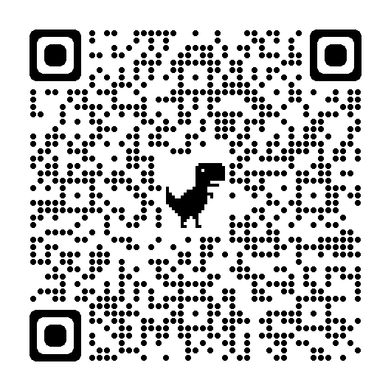
Easy: Inference (Colab) HuggingFace Pipelines
See here for a list of currently supported tasks
machine learning:
classification, regression,
token classification,
classify spans (Q&A), fill mask
speech:
speech-to-text (automatic speech recognition (ASR)),
text-to-speech (speech synthesis)
audio classification
vision:
image classification, video classification, image segmentation, image to text, visual question answering
natural language:
text classification
question answering
fill mask (Cloze task)
machine translation (MT)
feature extraction

Slide 25
“Easy Inference”
Replication
Plenty of Room for Improvement
Many students should be able to
Download models from hubs
And use them as intended
To do many useful things
Especially on first impression,
It is impressive how much
can be accomplished
with “easy inference”
But there is always
more work to do
Current solutions are
unlikely to stand up to test of time

Slide 26
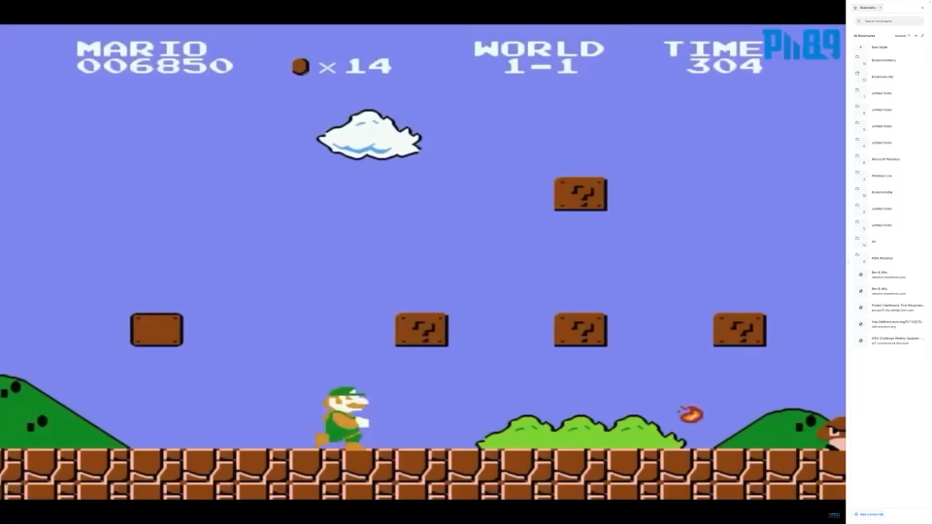
Test of time: Inference is cool (for now)
https://youtu.be/rLl9XBg7wSs

Slide 27
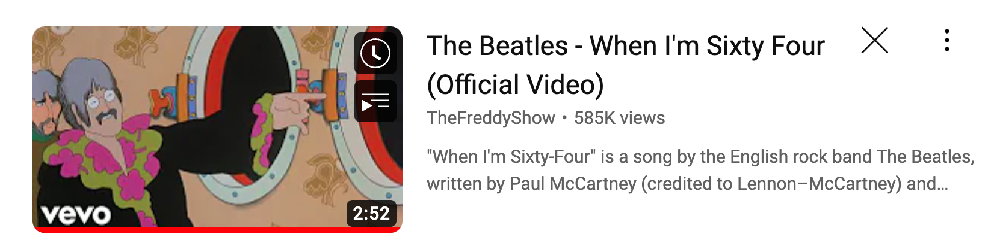
Test of time: Inference is cool (for now) Will you still love me when I’m Sixty Four?
https://www.youtube.com/watch?v=wUDRIC5RSX4

Slide 28
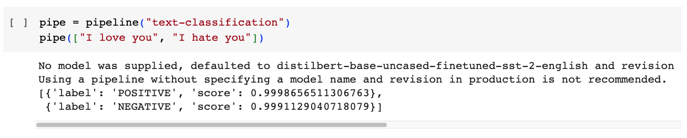
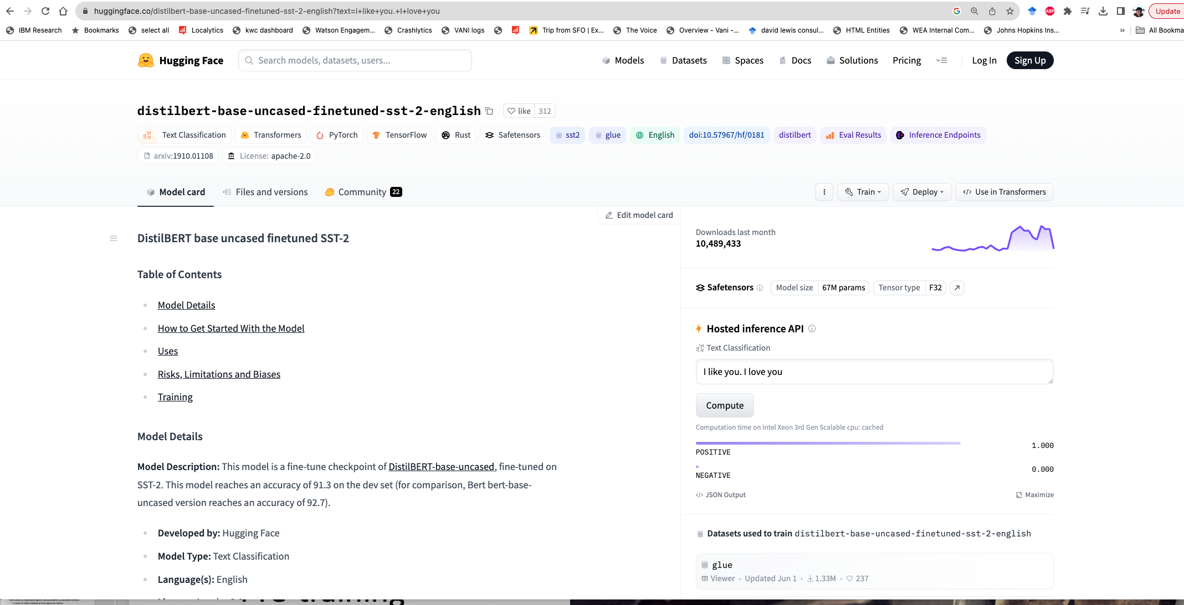
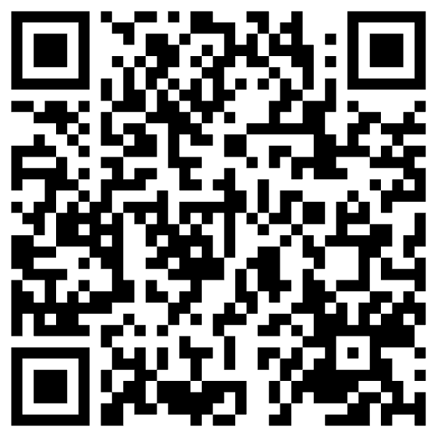

Slide 29
Input: I love you Output: Depends on Model (among other things)
Task: classify
Models:
Sentiment
Expected output label: positive
Fake News:
Expected output label: not fake (real)
Spam/Ham:
Expected output label: not spam (ham)
for model in …
do
echo I love you |
gft_predict \
--task classify \
--model $model
done

Slide 30
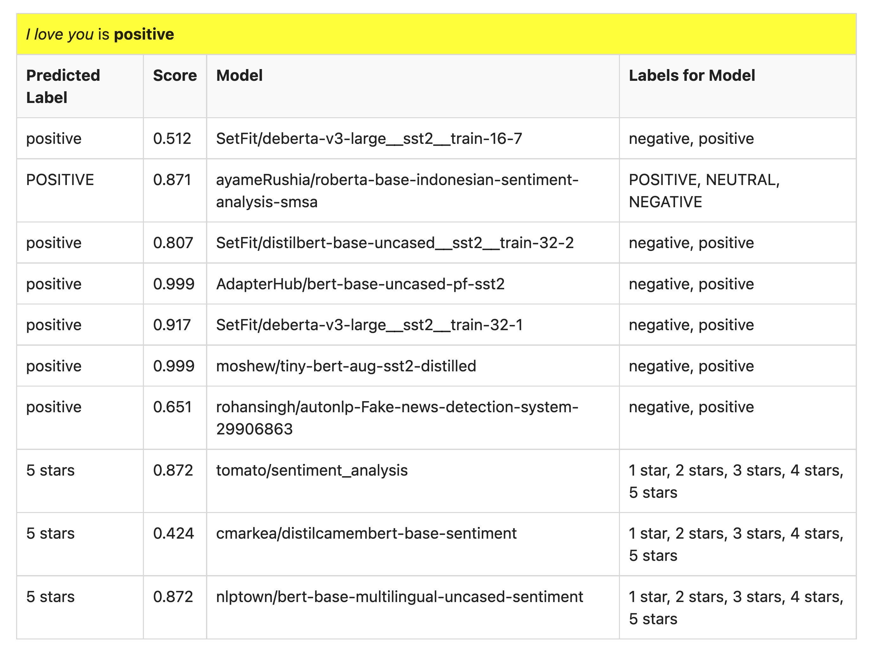
Many of these models produce reasonable results
Scores could be more confident

Slide 31
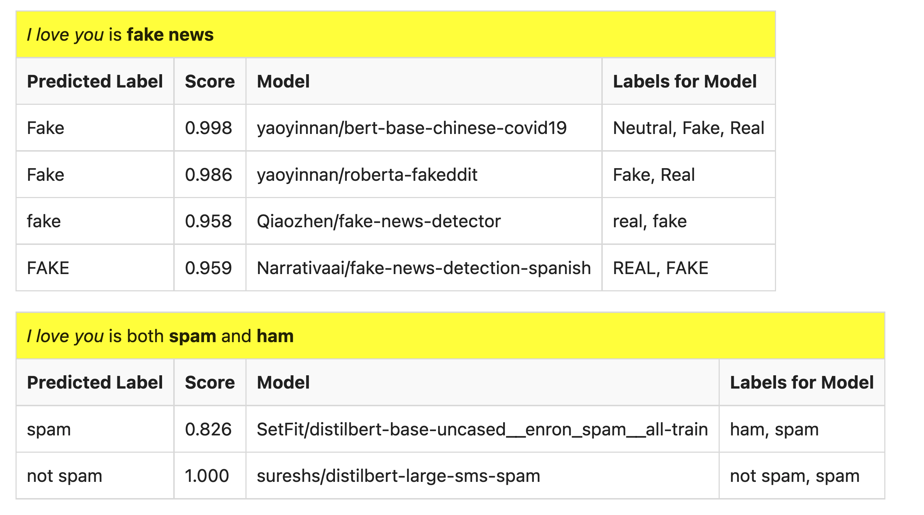
But…

Slide 32
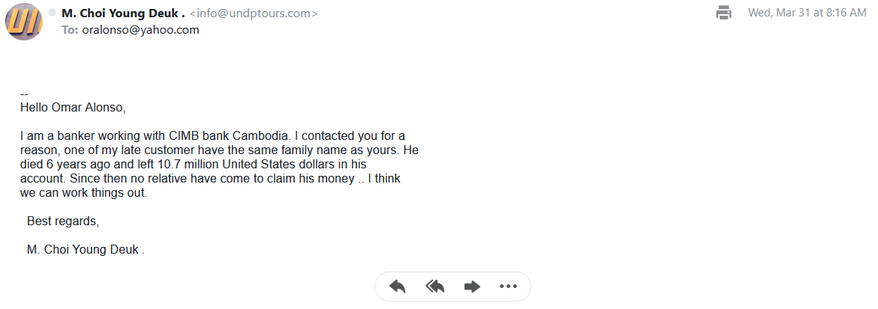
What is a label?
Spam email?
Label: yes, no

Slide 33
Ugly: Challenges for Classification
Benchmarks are small, clean, unrealistic…
Arms race, Adversarial attacks (GANs),
Labeling is not as easy as it might seem
Depends on context
Consider: adult content
Parents posted innocent videos of their kids on YouTube
But these videos went viral among not-so-innocent audience
Incentives:
If toxicity is profitable,
then use classifiers in reverse direction
to maximize toxicity (and profits)

Slide 34
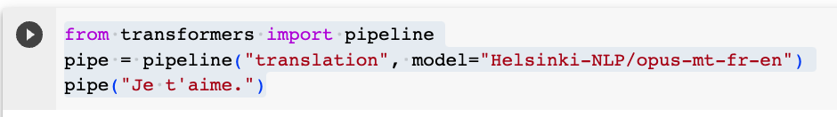
Another Example of Inference: Machine Translation (MT)

Slide 35
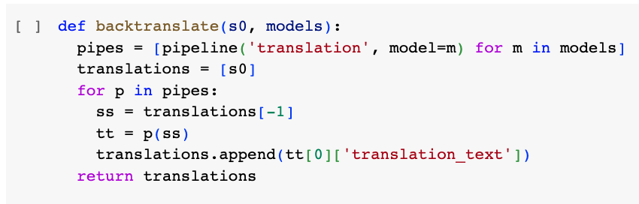
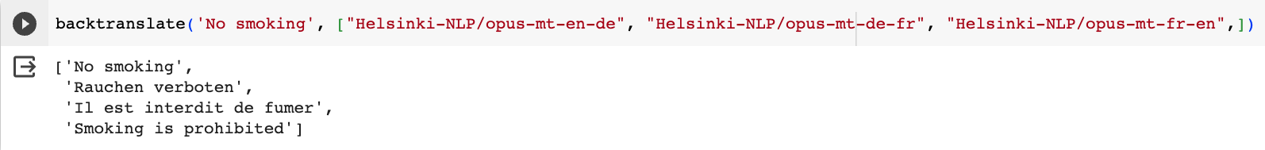
Back Translation

Slide 36
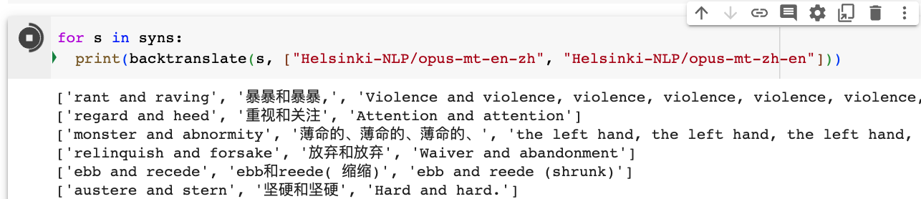
Back Translation of Synonyms

Slide 37
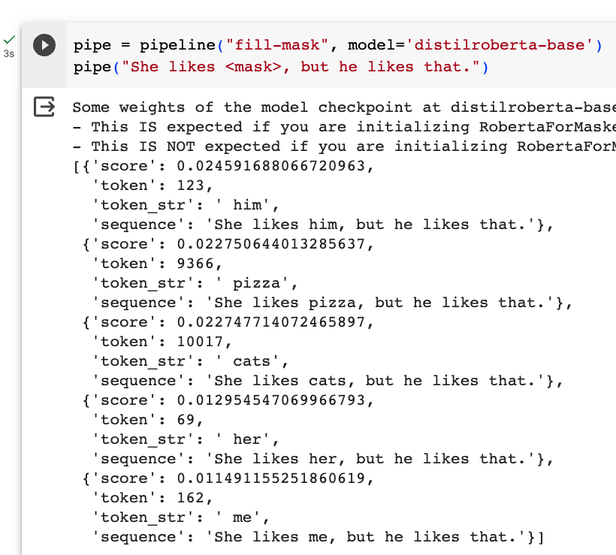
Fill Mask (Cloze Task)

Slide 38
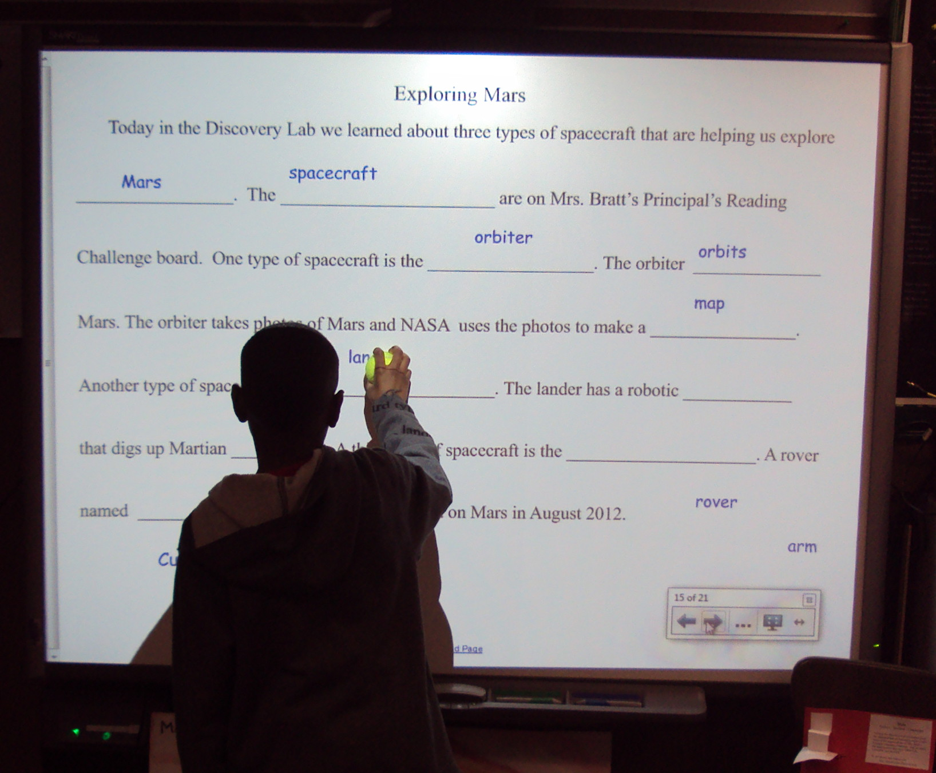
More Inference Tasks: Classification, Fill Mask, … echo … | gft_predict –task fill-mask
BERT: Fill-Mask (Delvin et al, 2019)
Cloze Task (1953)
Input | Choice 1 |  | Choice 2
I <mask> you | miss | 30% | love | 17%
I <mask> him | love | 14% | miss | 13%
I <mask> her | love | 16% | miss | 12%
I love <mask> | him | 2% | cats | 2%
I <mask> New York | love | 33% | miss | 17%
I love the <mask> guy | pizza | 2% | funny | 2%
I hate the <mask> guy | fucking | 3% | pizza | 2%
By Laurie Sullivan - DSC01784, CC BY 2.0, https://commons.wikimedia.org/w/index.php?curid=62727253

Slide 39
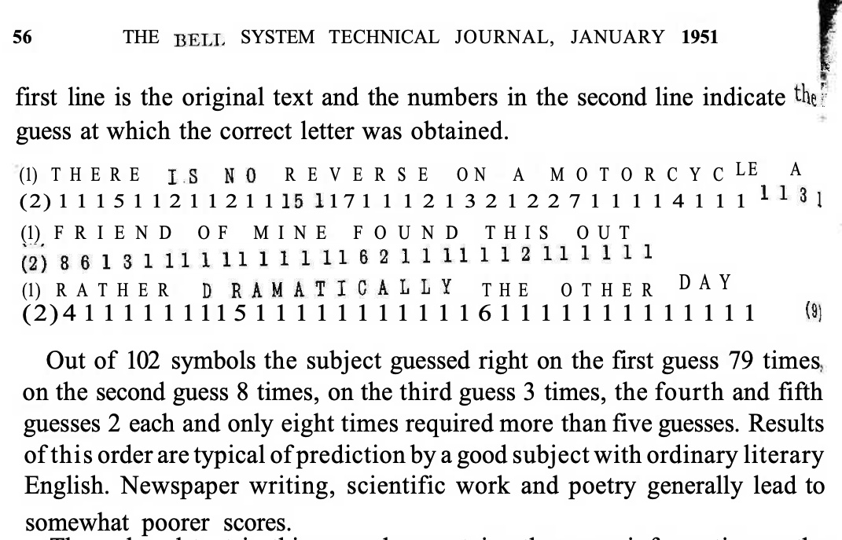
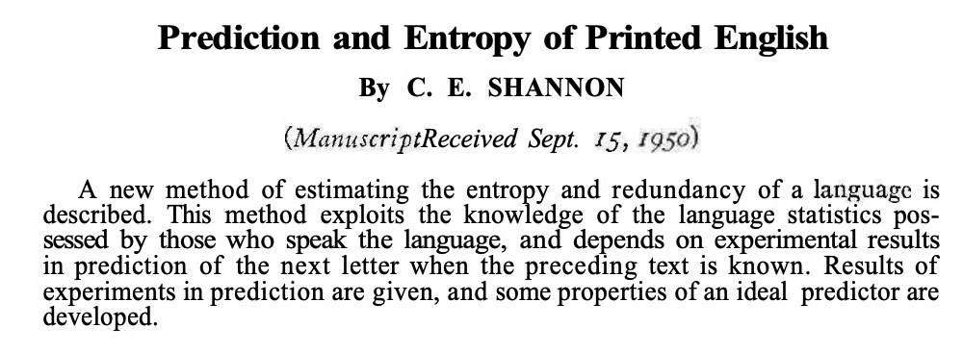
Lots of History: Fill-mask, Cloze Task, Entropy

Slide 40
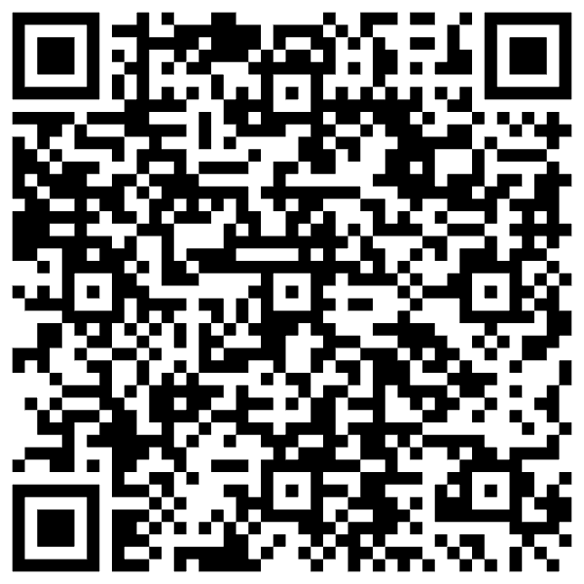
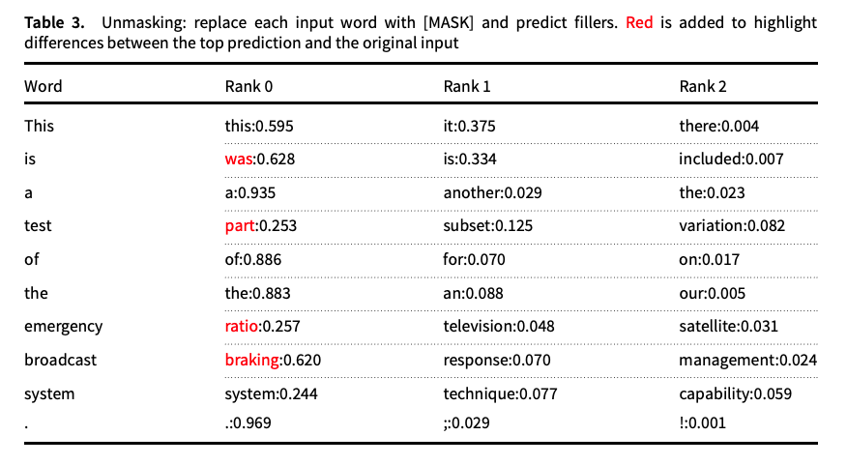
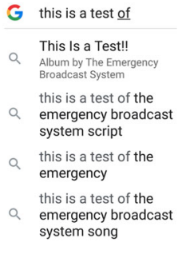
Guess the missing word in a cliché (from “Emerging trends: Deep nets for poets”)
Fill Mask
Autocomplete in Search

Slide 41
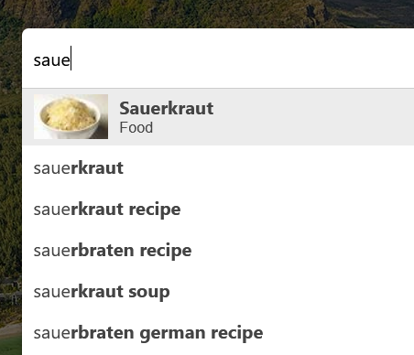
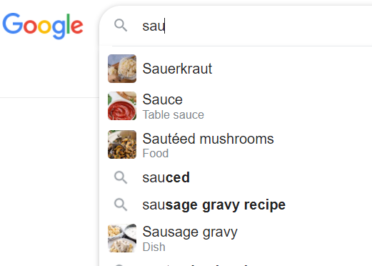
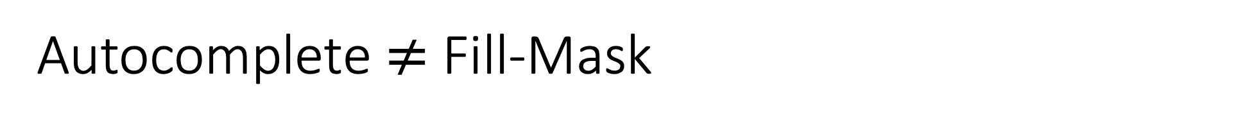
Autocomplete $≠$ Fill-Mask

Slide 42
Massive Growth → Mistaken Impression that everything is new (and there is no history)
Scientific literature doubles every 9 years (90% written since I started PhD)
What’s new
The world is taking notice (in AI)
Fluency is much improved
What’s not new
Chatbots (and much of the tech)
SOTA-Chasing
New/better shiny objects
(with same old quality?)
Does SOTA-Chasing → Progress?
Trustworthiness is still open

Slide 43
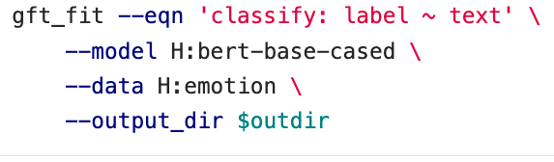
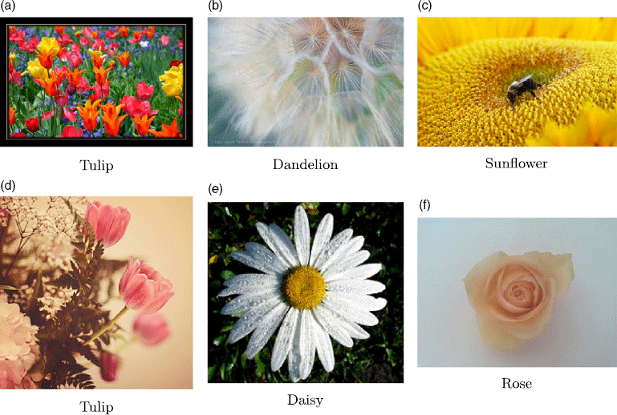
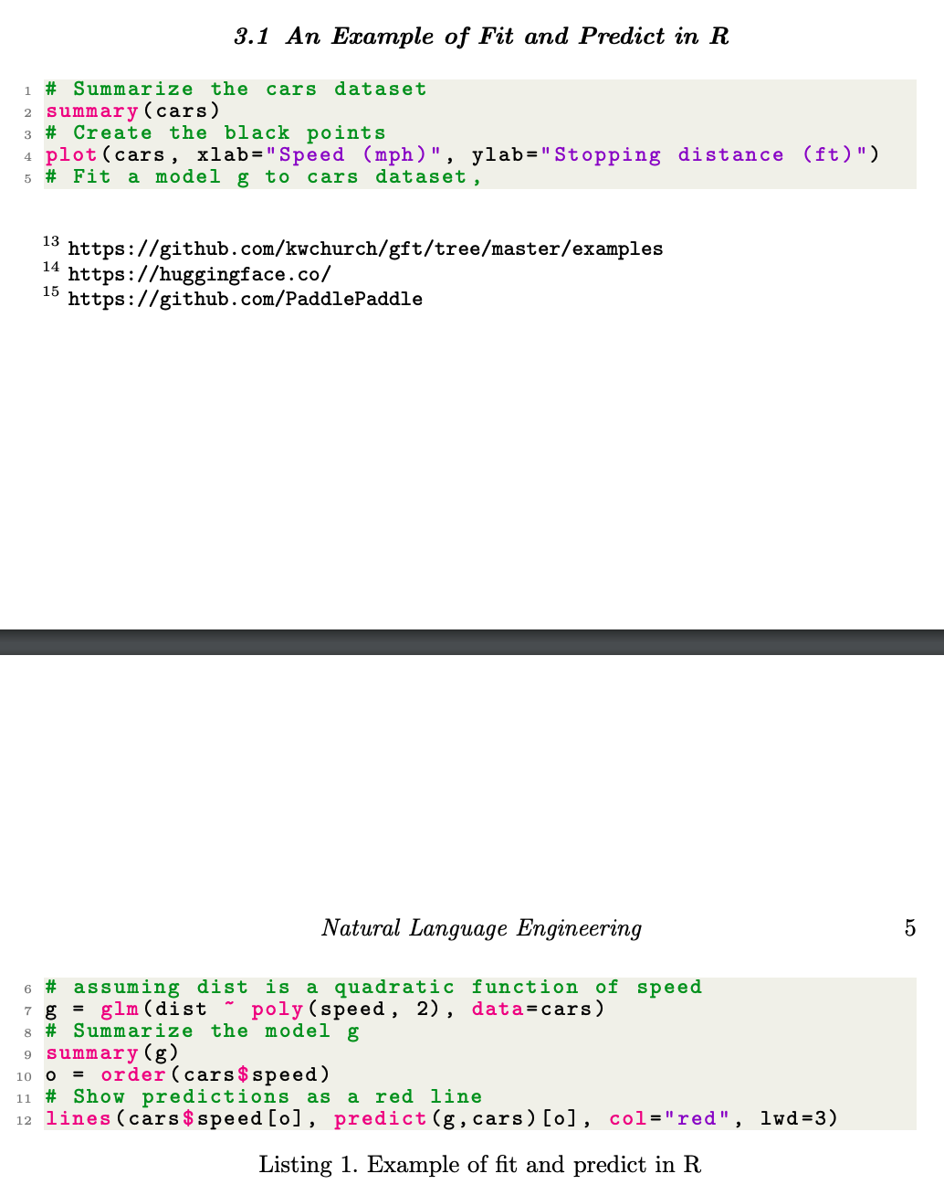
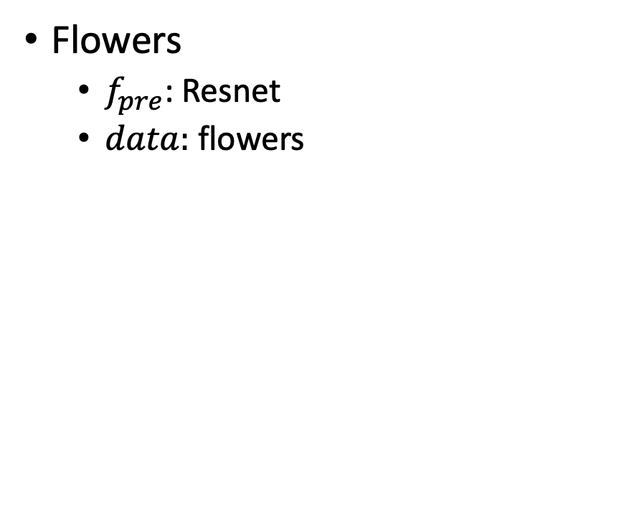
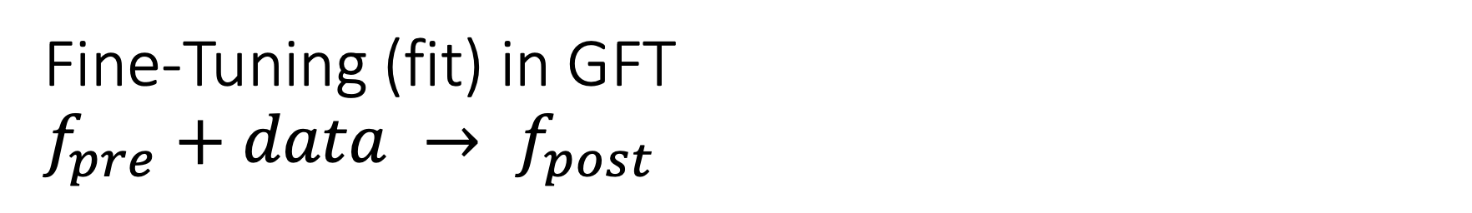
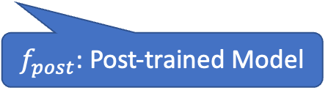
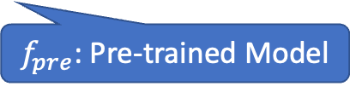
Fine-Tuning (fit) in GFT $f_{pre}+data → f_{post}$
Flowers
$f_{pre}$: Resnet
$data:$flowers
$f_{pre}$: Pre-trained Model
$f_{post}$: Post-trained Model
Fine-Tuning (fit) in R

Slide 44

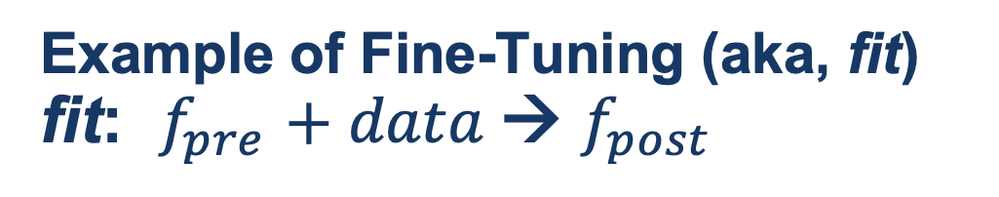
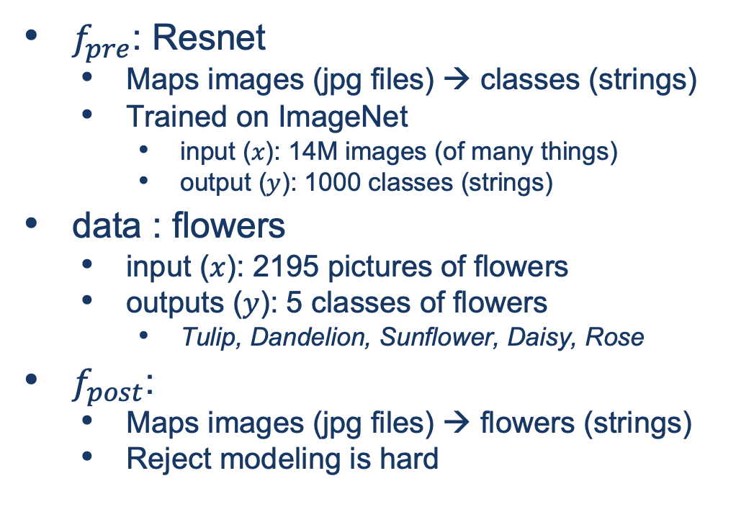
Guide Book App

Slide 45
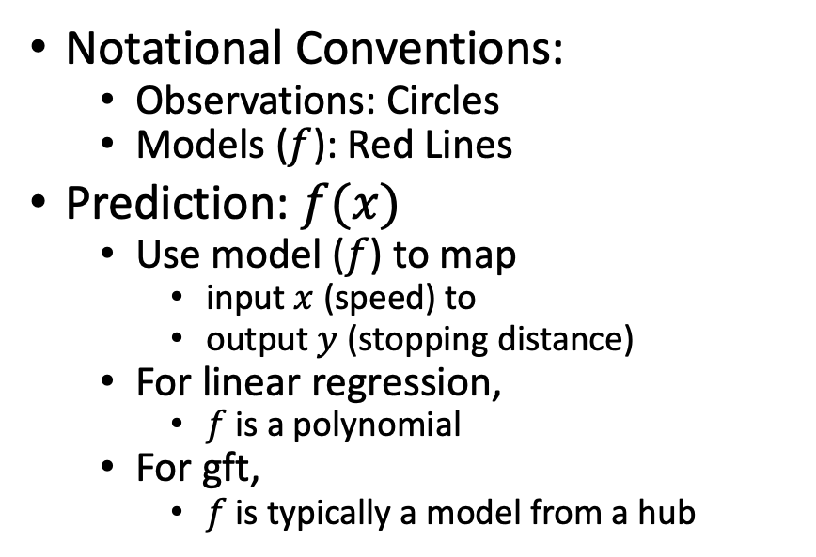
Fine-Tuning (Fit) in R (Statistics Package)
Make deep nets look like regression
(Not much programming)
Black Points:
cars dataset
Notational Conventions:
Observations: Circles
Models ($f$): Red Lines
Prediction: $f(x)$
Use model ($f$) to map
input $x$ (speed) to
output $y$ (stopping distance)
For linear regression,
$f$is a polynomial
For gft,
$f$is typically a model from a hub
Red Line:
Model (f)

Slide 46
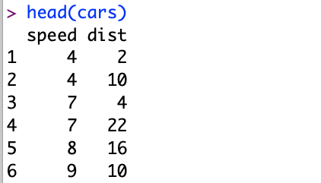
Datasets Example: Cars
Two Columns:
cars$speed
cars$dist

Slide 47
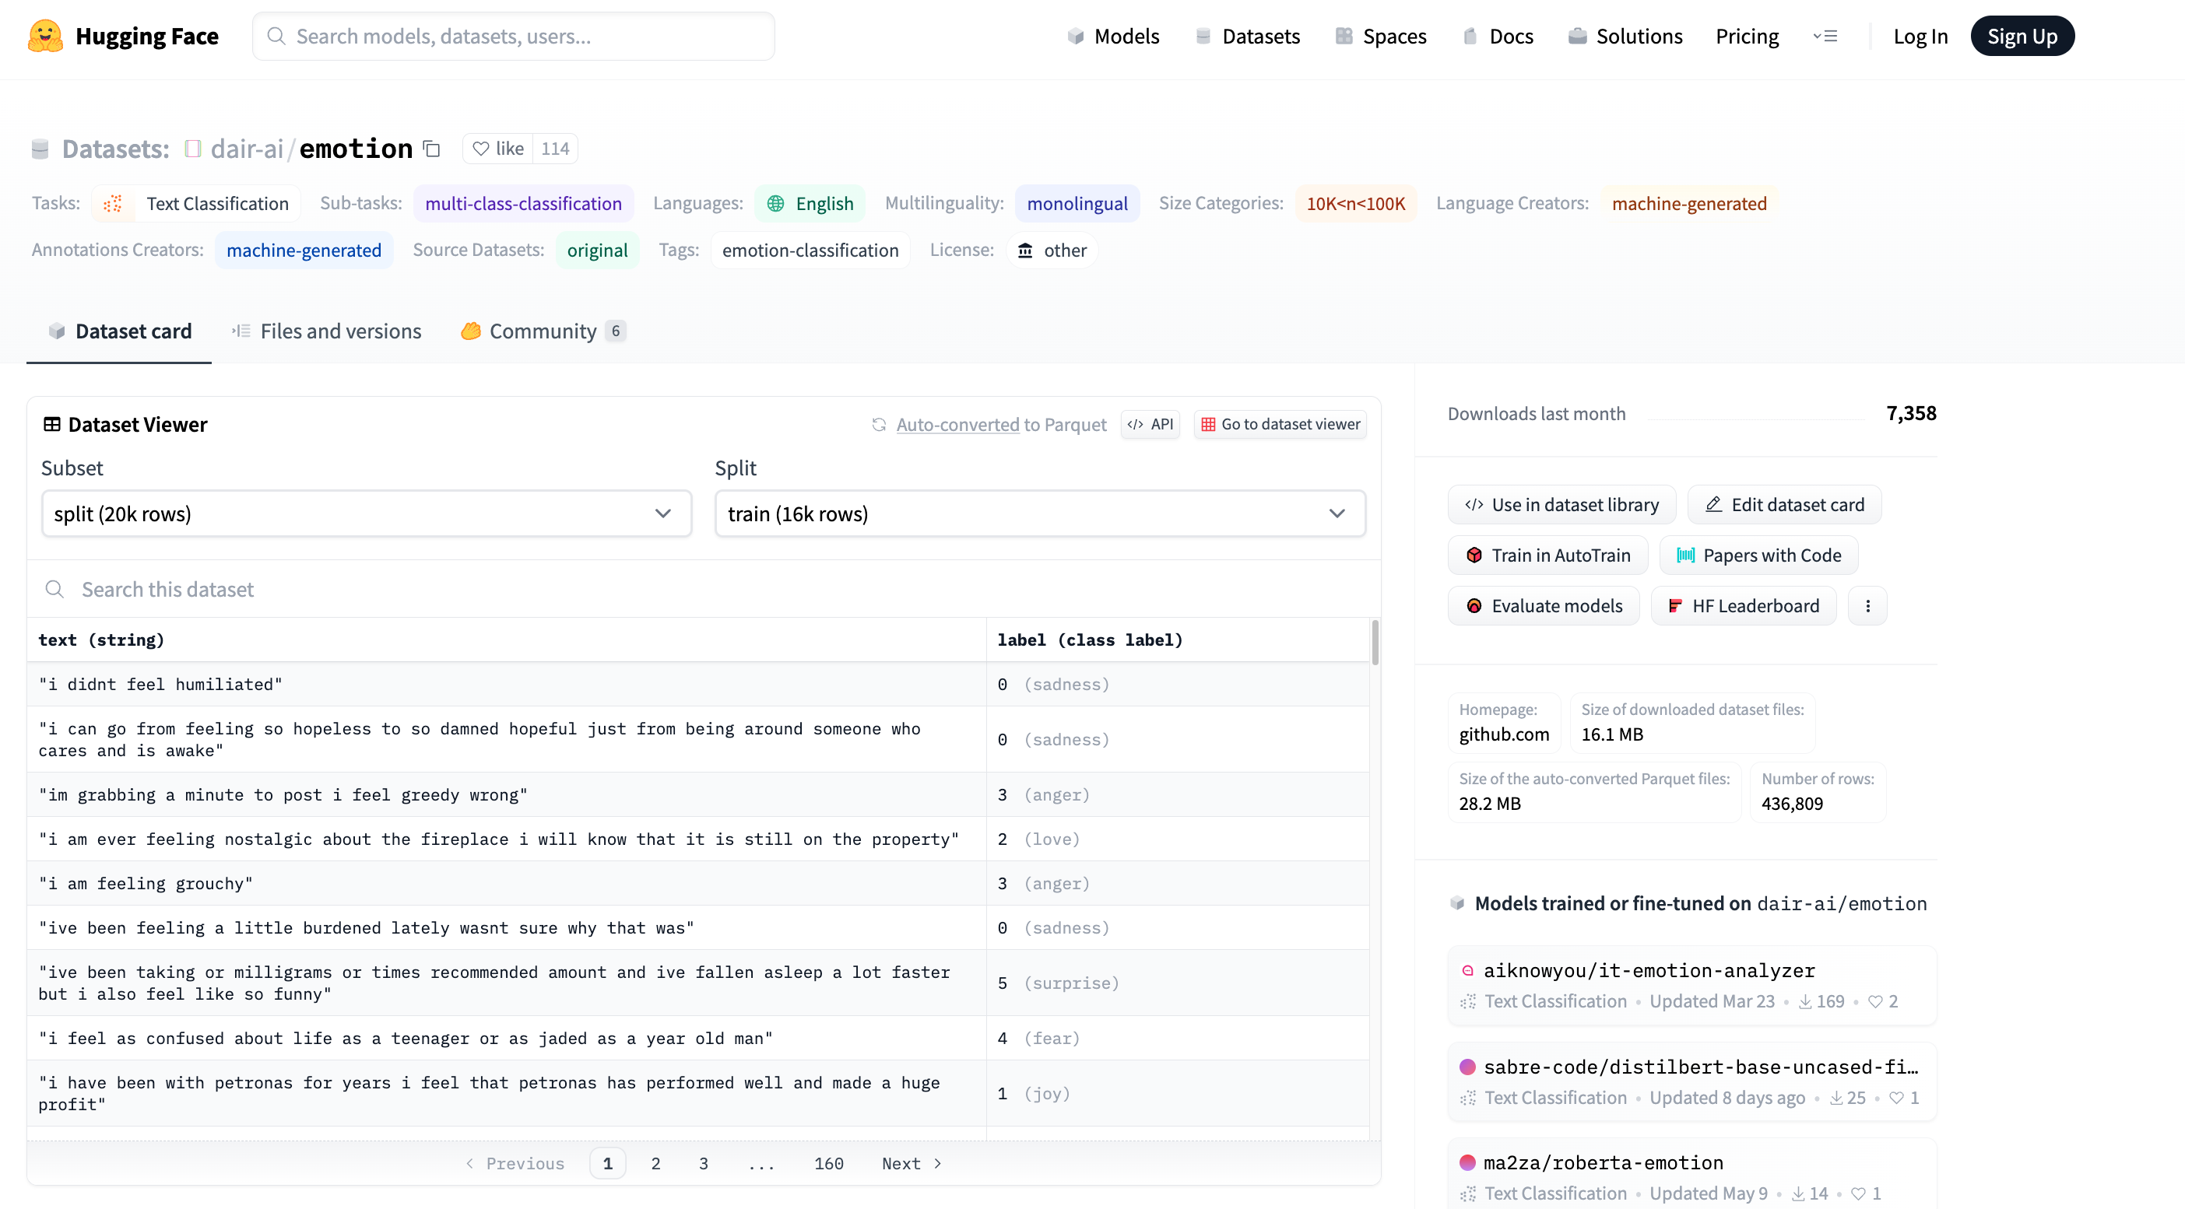


Example of Datasets in HuggingFace https://huggingface.co/datasets/dair-ai/emotion
$$x$$
$$y$$

Slide 48
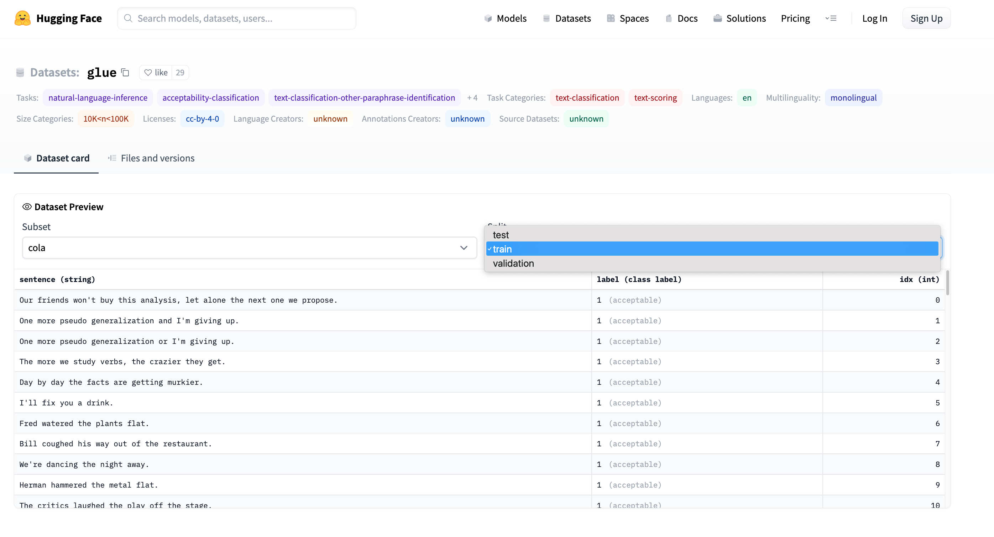
Emotion → GLUE (Cola) https://huggingface.co/datasets/glue/viewer/cola/train
Terminology: Splits
Terminology: Subset

Slide 49
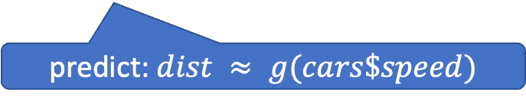
glm (General Linear Models) in R (and Sklearn)
glm: fit poly model with data
predict: $dist ≈ g(cars\$speed)$

Slide 50
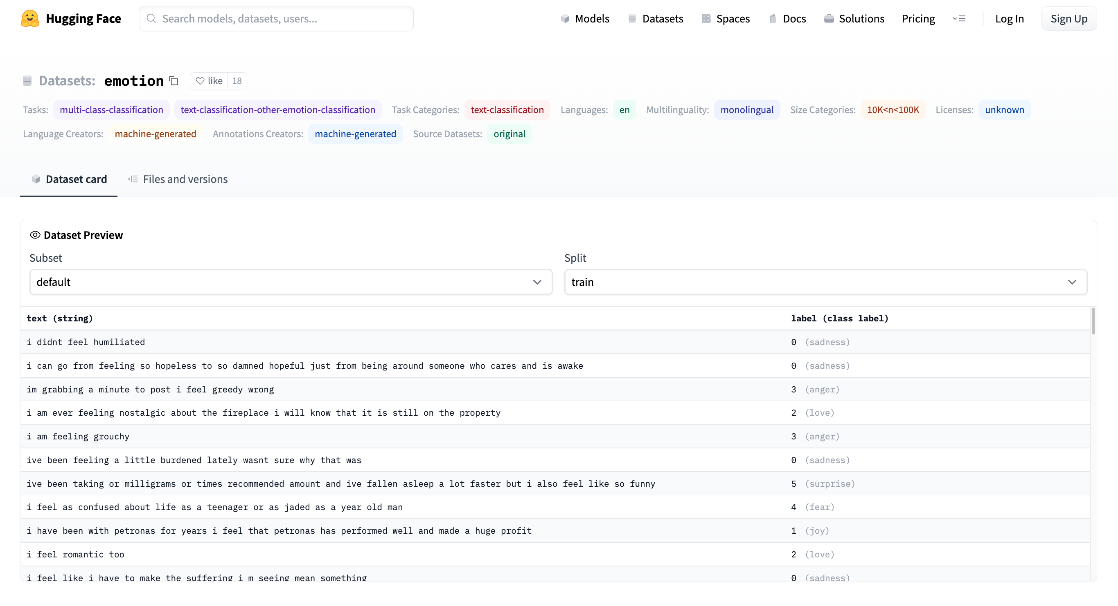
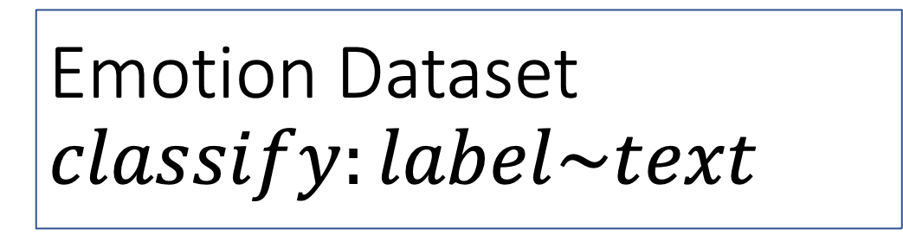
Emotion Dataset $$classify:label\sim text$$
Task/Loss
Columns
Columns
Row

Slide 51
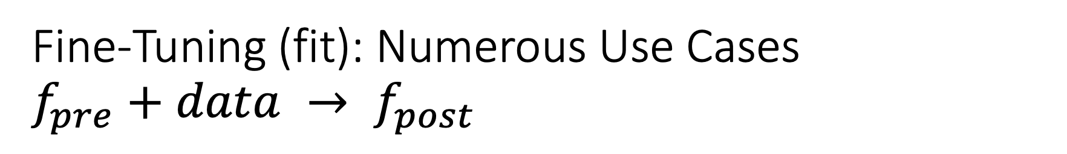
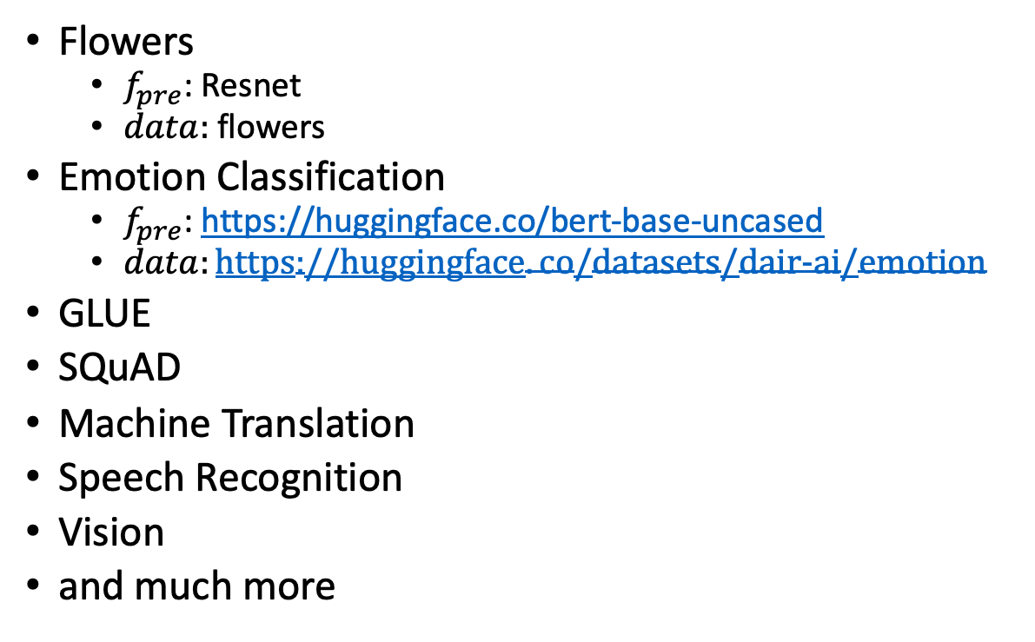
Fine-Tuning (fit): Numerous Use Cases $f_{pre}+data → f_{post}$
Flowers
$f_{pre}$: Resnet
$data:$flowers
Emotion Classification
$f_{pre}$: https://huggingface.co/bert-base-uncased
$data:https://huggingface.co/datasets/dair−ai/emotion$
GLUE
SQuAD
Machine Translation
Speech Recognition
Vision
and much more
$f_{pre}$: Pre-trained Model
$f_{post}$: Post-trained Model
Fine-Tuning (fit) in R

Slide 52
GLUE Subsets
GLUE COLA SUBSET
Sentence | Label
Bill sang himself to sleep. | 1 (acceptable)
Bill squeezed the puppet through the hole. | 1 (acceptable)
Bill sang Sue to sleep. | 1 (acceptable)
The elevator rumbled itself to the ground. | 0 (unacceptable)
If the telephone rang, it could ring itself silly. | 1 (acceptable)
She yelled hoarse. | 0 (unacceptable)
Ted cried to sleep. | 0 (unacceptable)
The tiger bled to death. | 1 (acceptable)
Subset | Dataset
COLA | H:glue,cola
SST2 | H:glue,sst2
WNLI | H:glue,wnli
MRPC | H:glue,mrpc
QNLI | H:glue,qnli
QQP | H:glue,qqp
SSTB | H:glue,sstb
MNLI | H:glue,mnli

Slide 53
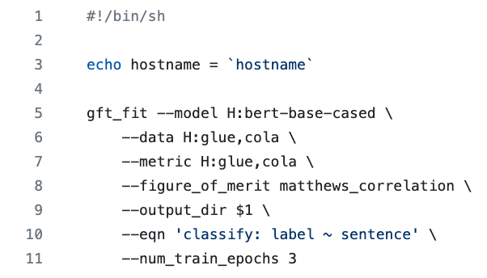
GFT Program for COLA
GLUE COLA SUBSET
Sentence | Label
Bill sang himself to sleep. | 1 (acceptable)
Bill squeezed the puppet through the hole. | 1 (acceptable)
Bill sang Sue to sleep. | 1 (acceptable)
The elevator rumbled itself to the ground. | 0 (unacceptable)
If the telephone rang, it could ring itself silly. | 1 (acceptable)
She yelled hoarse. | 0 (unacceptable)
Ted cried to sleep. | 0 (unacceptable)
The tiger bled to death. | 1 (acceptable)
https://github.com/kwchurch/gft/blob/master/examples/fit_examples/model.HuggingFace/language/data.HuggingFace/glue/cola.sh

Slide 54

Simple Equations Cover Many Cases of Interest GLUE: A Popular Benchmark
Subset | Dataset | Equation
COLA | H:glue,cola | $$classify : label \sim sentence$$
SST2 | H:glue,sst2 | $$classify : label \sim sentence$$
WNLI | H:glue,wnli | $$classify : label \sim sentence$$
MRPC | H:glue,mrpc | $$classify : label \sim sentence1 + sentence2$$
QNLI | H:glue,qnli | $$classify : label \sim sentence1 + sentence2$$
QQP | H:glue,qqp | $$classify : label \sim question+sentence$$
SSTB | H:glue,sstb | $$regress : label \sim question1+question2$$
MNLI | H:glue,mnli | $$classify : label \sim premise+hypothesis$$

Slide 55


Equation Keywords $≈$ Pipeline Tasks
Benchmark | Subset | Dataset | Equation
GLUE | COLA | H:glue,cola | $$classify : label \sim sentence$$
SQuAD 1.0 |  | H:squad | $$classify_spans:answers\sim question+context$$
SQuAD 2.0 |  | H:squad_v2 | $$classify_spans:answers\sim question+context$$
CONLL2003 | POS | H:conll2003 | $$classify_tokens:pos_tags\sim tokens$$
 | NER | H:conll2003 | $$classify_tokens:ner_tags\sim tokens$$
TIMIT |  | H:timit_asr | $$ctc :text\sim audio$$
Amazon Reviews |  | H:amazon_reviews_multi | $$classify : label \sim question+sentence$$
VAD |  | C:$gft/datasets/VAD/VAD | $$regress: Valence + Arousal + Dominance \sim Word$$

Slide 56


gft Cheat Sheet (General Fine-Tuning)
4+1 Functions
4 Arguments
gft_fit: $f_{pre}$ →$f_{post}$(fine-tuning)
4 Arguments, --output_dir, --metric, --splits
(plus most args in most hubs)
gft_predict: $f\left(x\right)→\hat{y}$ (inference)
Input: 4 Arguments ($x$ from data or stdin)
Output: $\hat{y}$ for each $x$
gft_eval: Score model on dataset
Input: 4 Arguments, --split, --metric, …
Output: Score
gft_summary: Find good stuff
Input: 4 Arguments
(may include: __contains__, __infer__)
gft_cat_dataset: Output data to stdout
Input: 4 Arguments (--data, --eqn)
--data
--model
--eqn $task:y\sim x_{1}+x_{2}$
--task
classify (text-classification)
classify_tokens (token-classification)
classify_spans (QA, question-answering)
classify_audio (audio-classification)
classify_images (image-classification)
regress
text-generation
MT (translation)
ASR (ctc, automatic-speech-recognition)
fill-mask

Slide 57

Regression in R: Summarize (almost) anything
Fit a model (g) to data (cars)

Slide 58

Regression in R: Summarize (almost) anything

Slide 59
Regression in R: Summarize (almost) anything
Fit a model (g) to data (cars)
Predict
Summarize a model (g)
Opportunity to Improve g

Slide 60
gft_summary
Summarize almost anything
Models
Datasets

Slide 61





Tasks
$$y∈\left\{0,1,2,…\right\}$$
classify, text-classification
regress
QA, Question Answering, classify spans
token classification
NER (Named Entity Recognition)
POS (Part of Speech Tagging)
translation, MT
ASR, Automatic Speech Recognition, ctc
$y∈ℝ$ or $y∈ℝ^{N}$
$y$ for each start/end of span
$y$ for each token
$y$ for each phoneme

Slide 62

gft Cheat Sheet (General Fine-Tuning)
4+1 Functions
4 Arguments
gft_fit: $f_{pre}$ →$f_{post}$(fine-tuning)
4 Arguments, --output_dir, --metric, --splits
(plus most args in most hubs)
gft_predict: $f\left(x\right)→\hat{y}$ (inference)
Input: 4 Arguments ($x$ from data or stdin)
Output: $\hat{y}$ for each $x$
gft_eval: Score model on dataset
Input: 4 Arguments, --split, --metric, …
Output: Score
gft_summary: Find good stuff
Input: 4 Arguments
(may include: __contains__, __infer__)
gft_cat_dataset: Output data to stdout
Input: 4 Arguments (--data, --eqn)
--data
--model
--eqn $task:y\sim x_{1}+x_{2}$
--task
classify (text-classification)
classify_tokens (token-classification)
classify_spans (QA, question-answering)
classify_audio (audio-classification)
classify_images (image-classification)
regress
text-generation
MT (translation)
ASR (ctc, automatic-speech-recognition)
fill-mask

Slide 63
Easy Conclusions: Inference (Colab) HuggingFace Pipelines
See here for a list of currently supported tasks
machine learning:
classification, regression,
token classification,
classify spans (Q&A), fill mask
speech:
speech-to-text (automatic speech recognition (ASR)),
text-to-speech (speech synthesis)
audio classification
vision:
image classification, video classification, image segmentation, image to text, visual question answering
natural language:
text classification
question answering
fill mask (Cloze task)
machine translation (MT)
feature extraction

